Slide 1
Text Classification
Lab 3

Slide 2
Text Classification
Authorship identification
Age/gender identification
Language Identification
Assigning topics such as Yahoo-categories e.g., "finance," "sports," "news>world>asia>business"
Genre-detection e.g., "editorials" "movie-reviews" "news“
Opinion/sentiment analysis on a person/product e.g., “like” , “hate” , “neutral”
Labels may be domain-specific e.g., “contains adult language” : “doesn’t”

Slide 3
Sentiment analysis Google Product Search
a

Slide 4
Sentiment analysis has many other names
Opinion extraction
Opinion mining
Sentiment mining
Subjectivity analysis

Slide 5
Dependencies
Pandas
a fast, powerful, flexible and easy to use open source data analysis and manipulation tool.
Install it using .. conda install pandas
10 minutes to pandas https://pandas.pydata.org/pandas-docs/stable/getting_started/10min.html
Read csv file import pandas as pd corpus = pd.read_csv(r'emails.csv')

Slide 6
Dependencies Cont.
Matplotlib
a comprehensive library for creating static, animated, and interactive visualizations in Python
Install it using … conda install -c conda-forge matplotlib

Slide 7
Dependencies
scikit-learn
machine learning in Python
Install it using .. conda install -c anaconda scikit-learn

Slide 8
Lab 3 Steps
Reading emails corpus
Preprocess text using nltk
Extracting features
Text classification
Training Model
Performance measure
Confusion matrix
Accuracy
Recall
Predict on testset
BOW
Remove stop words
Word Stem
Pandas.read_csv(corpus_path)
TF-IDF

Slide 9
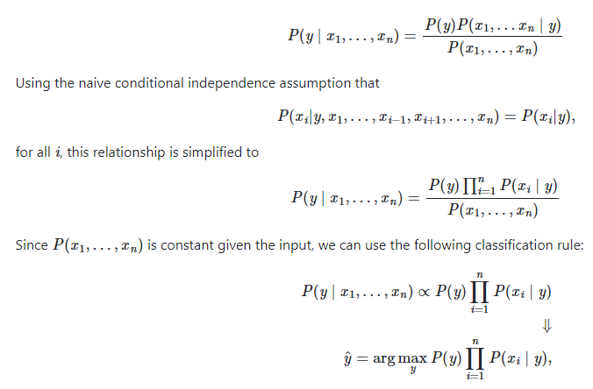
Naive Bayes
Bayes’ theorem states the following relationship, given class variable y and dependent feature vector x1 through xn, :

Slide 10


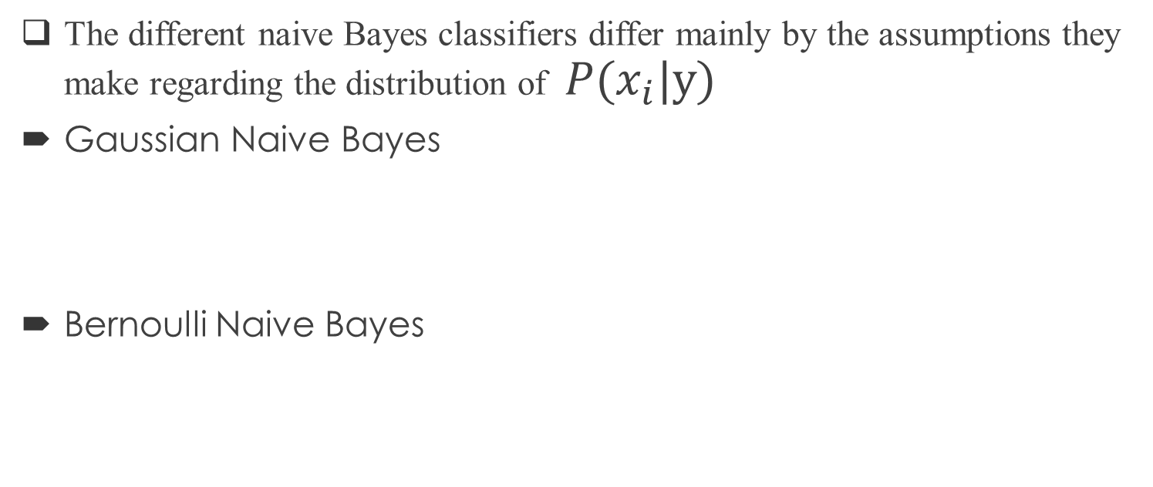
Naive Bayes Cont.
The different naive Bayes classifiers differ mainly by the assumptions they make regarding the distribution of
Bernoulli Naive Bayes

Slide 11
Naive Bayes Cont.
For more details https://scikit-learn.org/stable/modules/naive_bayes.html

